Slide 1
Swiggy’s Restaurant Recommendation System using Streamlit
Prepared By: MUKESH KANNAN S

Slide 2
The Problem Statement
Challenge: Swiggy has over 140,000+ restaurants. Users often face "Choice Paralysis"—too many options make it hard to decide.
Goal: Create a lightweight, fast, and accurate recommendation engine that filters by city, cuisine, and budget.

Slide 3
System Architecture
Data Source: Swiggy Dataset (City, Cuisine, Rating, Cost, Link).
Workflow:
Preprocessing: Handling missing values and formatting currency.
Feature Engineering: One-Hot Encoding for categorical data.
Engine: Cosine Similarity matrix calculation.
UI: Interactive Streamlit Dashboard.

Slide 4
Data Preprocessing & Feature Engineering
Cleaning: Removing duplicates and handling the "--" ratings.
Sampling: Optimized the dataset to 20,000 records for high-speed performance.
Vectorization: Converted text data (Cities/Cuisines) into numerical vectors using
One-Hot Encoding.

Slide 5
The Recommendation Logic
Algorithm: Content-Based Filtering.
Outcome: The system recommends restaurants that are mathematically "closest" to the user's selected preferences.

Slide 6
Key Features of the App
City-Specific Filtering: Users only see cuisines available in their selected city.
Dynamic Budget Slider: Real-time filtering based on the "Cost for Two."
Direct Action: Integrated "Order Now" buttons that link directly to Swiggy’s live website.
Speed: Cached data loading for near-instant results.

Slide 7
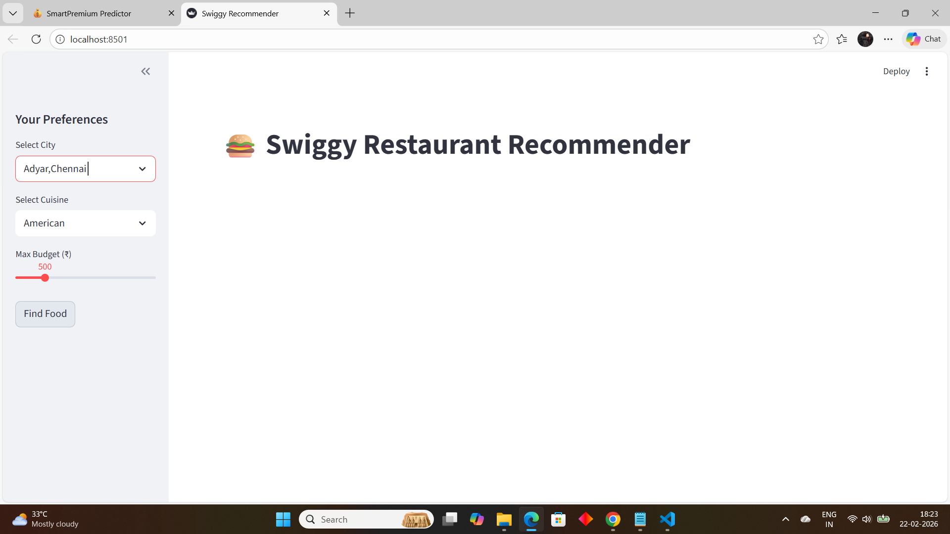
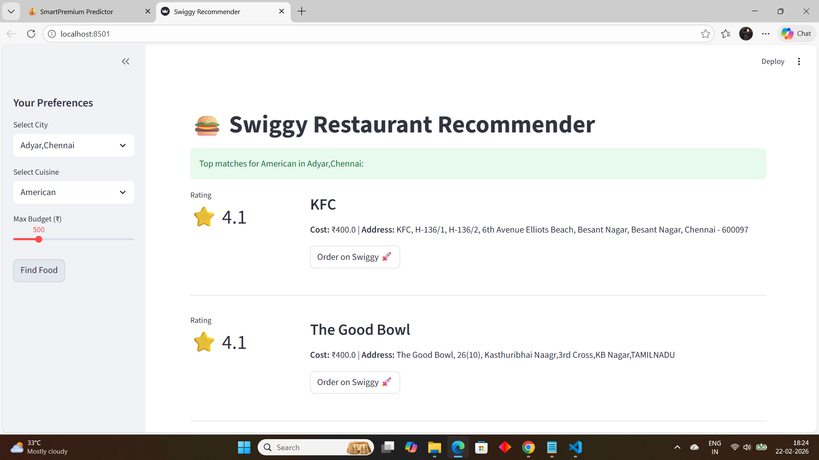
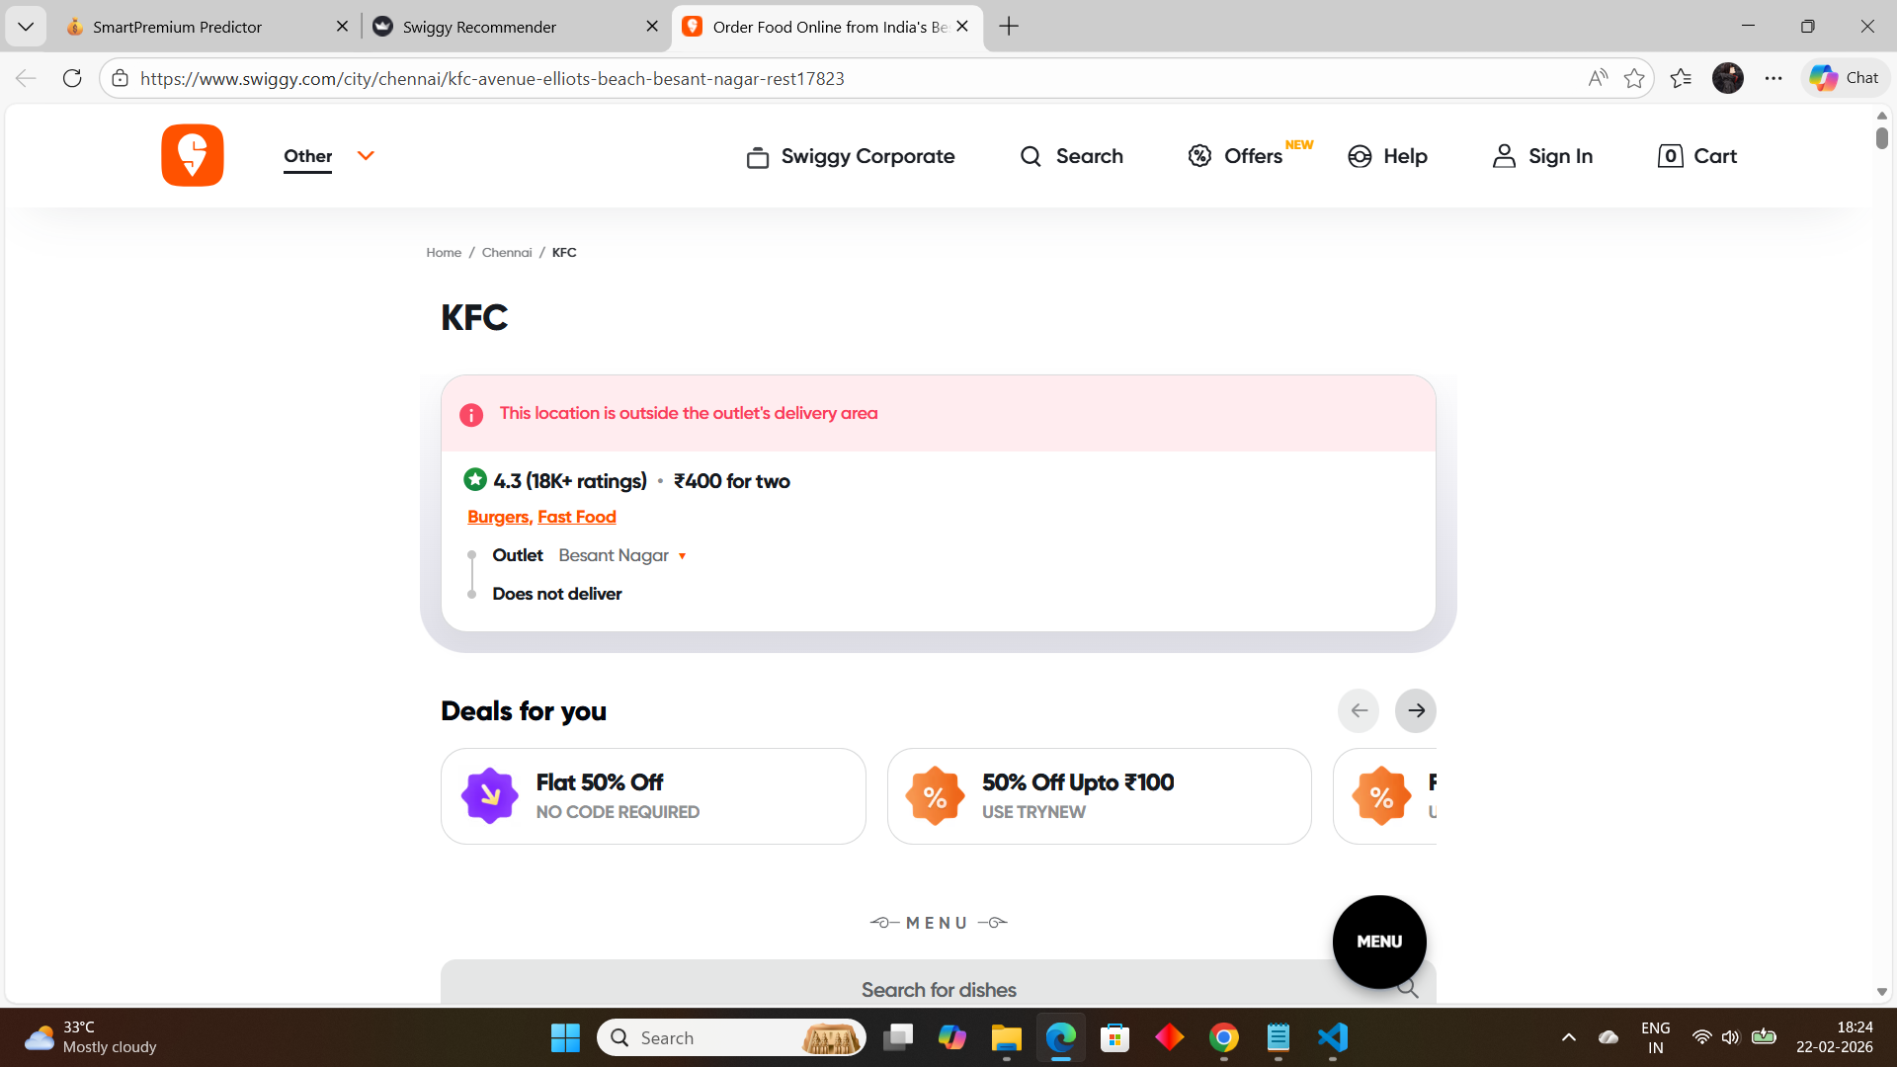
Results & Screenshots
User Flow: Select City → Select Cuisine → Adjust Budget → View Top 5 Matches.

Slide 8
THANK YOU

